Slide 1

Event-Management-System
Software Engineering
Team Leader: Zeyad Elshayeb
Team Members: Retaj Reda & Sara Sameh
With TA: Maram Alazab
Supervised By: Dr. Mohameds Sami Rakha

Slide 2

Project Overview
Web-based event management systemAllows users to browse events, register, and submit feedbackDeveloped using Flask following MVC architecture

Slide 3

Problem Statement
Manual event management is inefficientUsers need an easy way to discover and register for eventsFeedback collection is important for improving future events

Slide 4
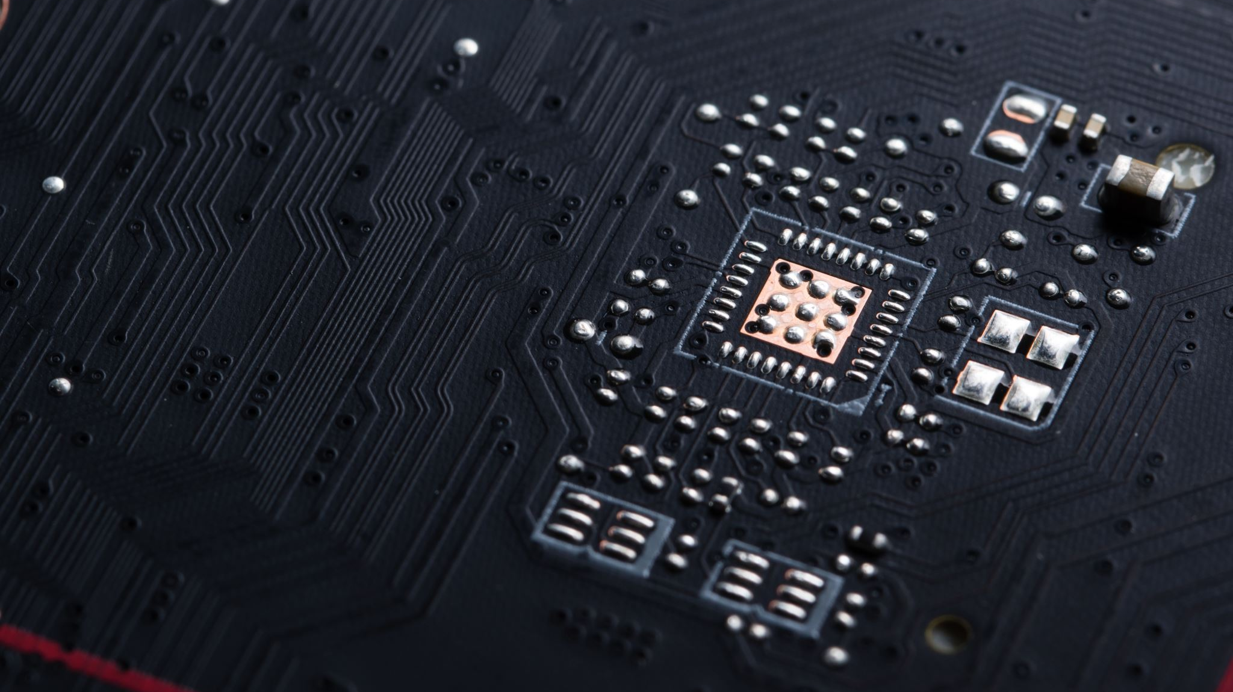
Technologies Used
Python & Flask
HTML & CSS
SQLiteGit, GitHub, Docker & unittest

Slide 5
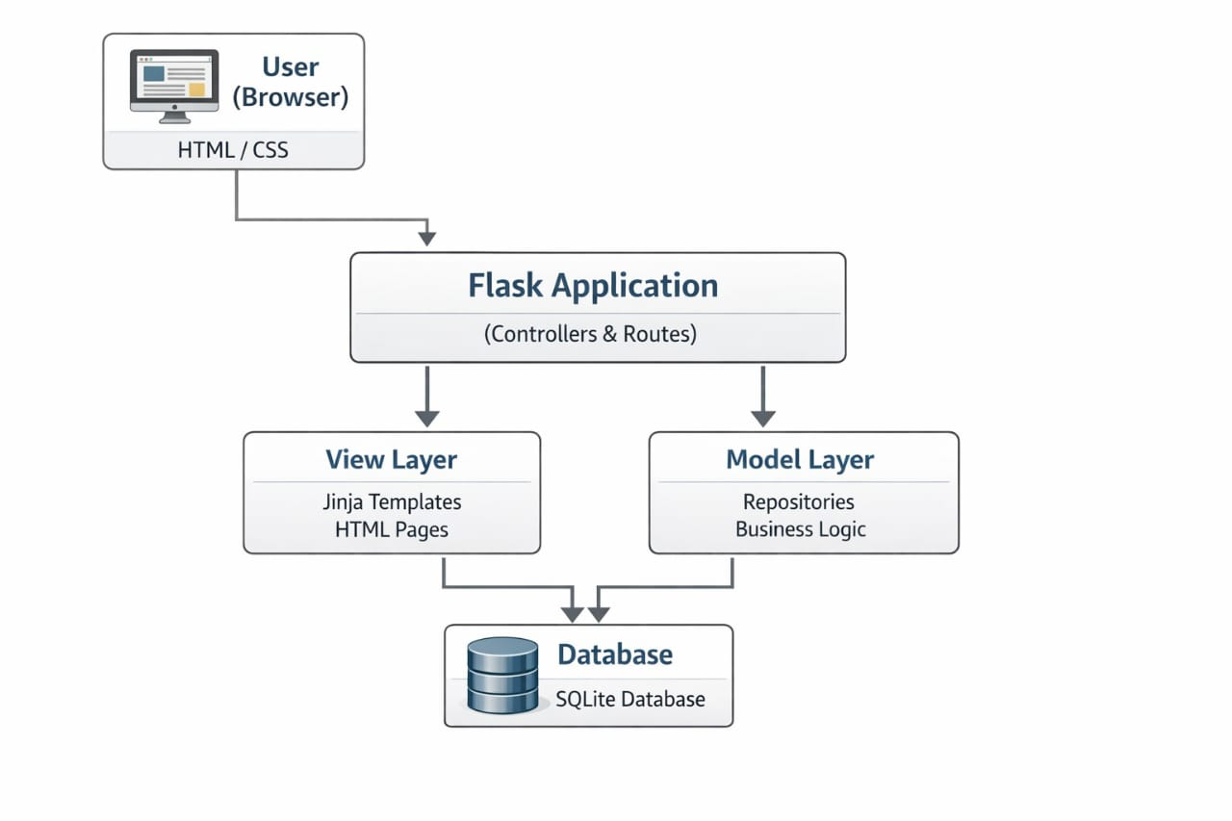
System Architecture (MVC)
Model: Database and repositories
View: HTML templates
Controller: Flask controllers

Slide 6
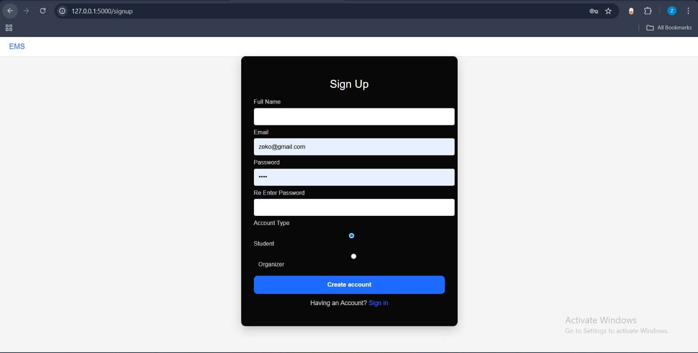
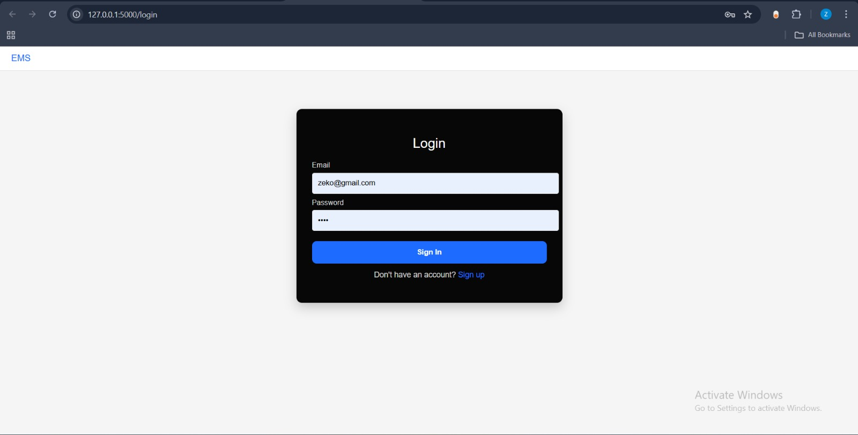
Authentication
User signup and login functionality
Session-based authentication
Secure password handling

Slide 7
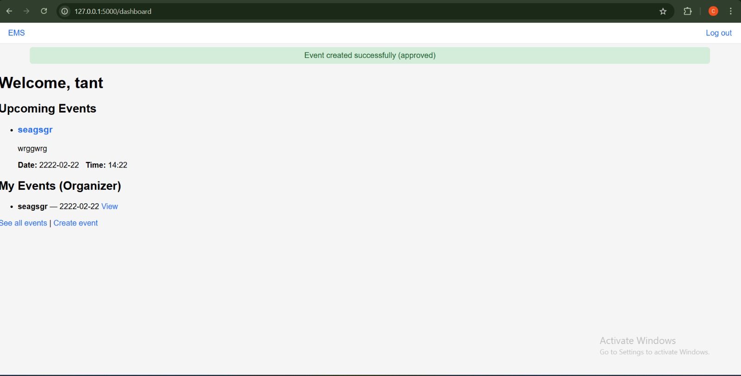
Dashboard & Events
Displays available events
Clear event information
Easy navigation

Slide 8
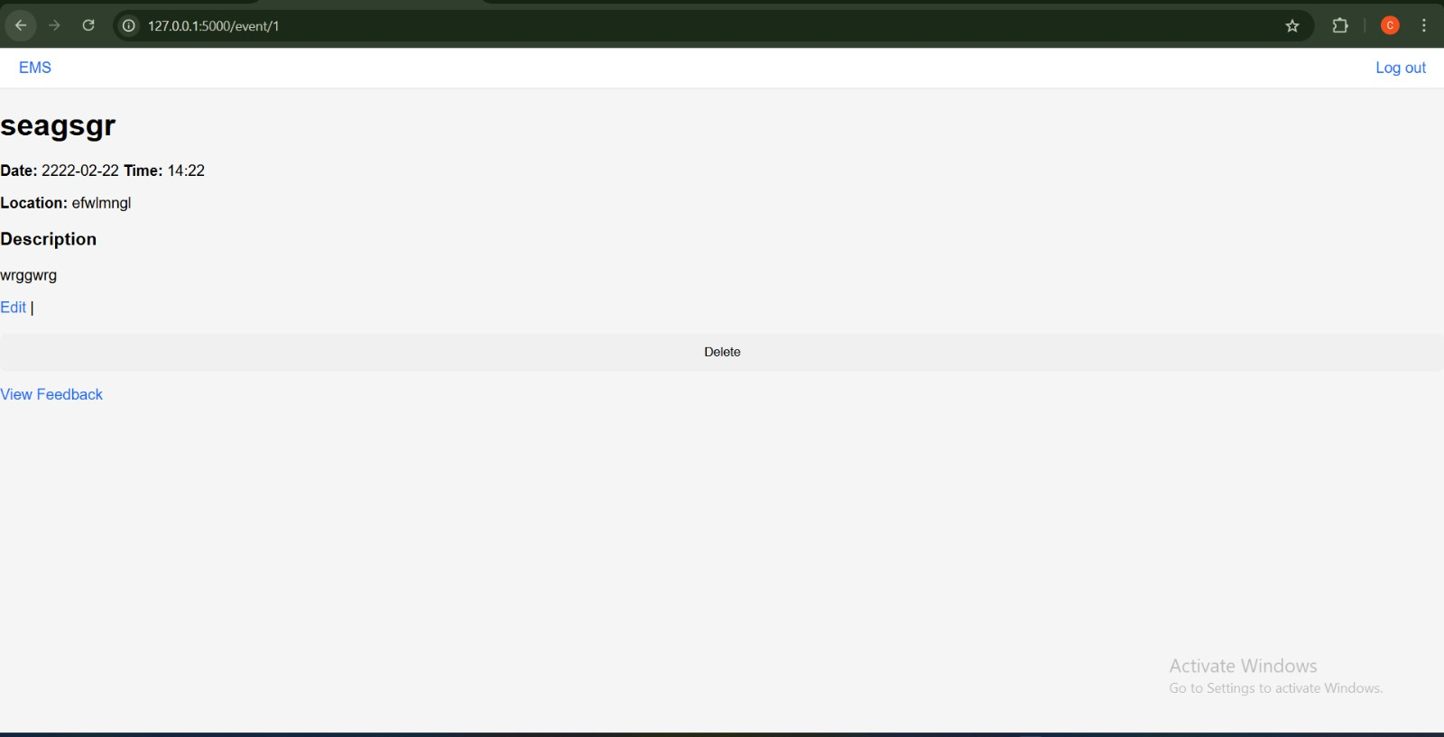
Event Details & Registration
View detailed event information
Register for events
Manage registration status

Slide 9
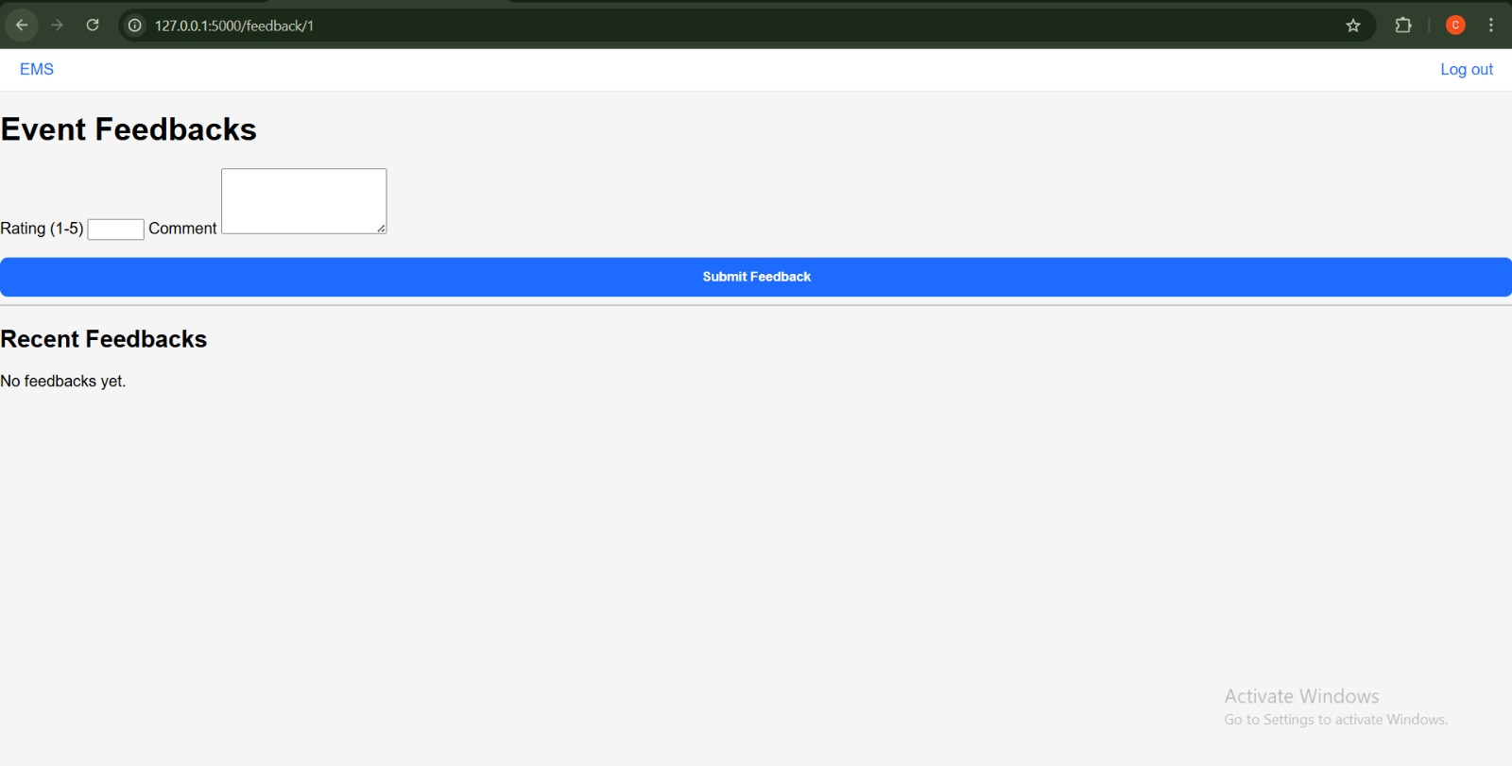
Feedback Feature
Users can submit feedback
Event rating and comments
Helps improve events

Slide 10
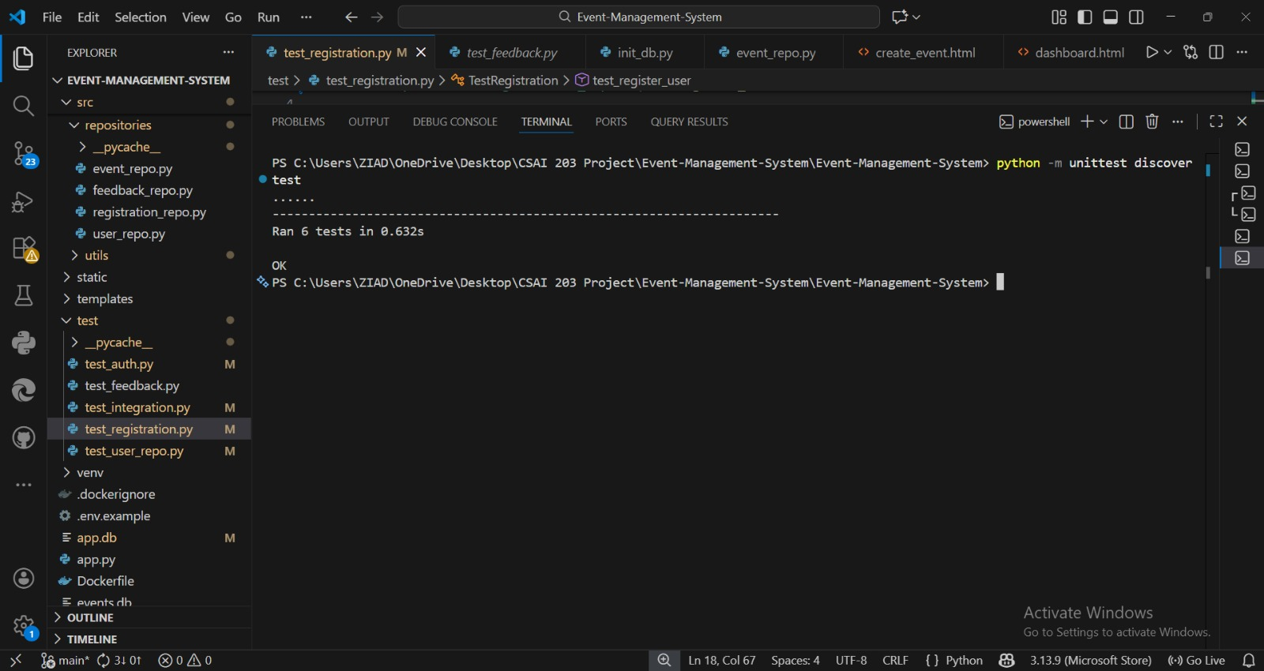
Testing
Unit tests implemented using unittest
Repository and logic testing
Integration testing for routing

Slide 11
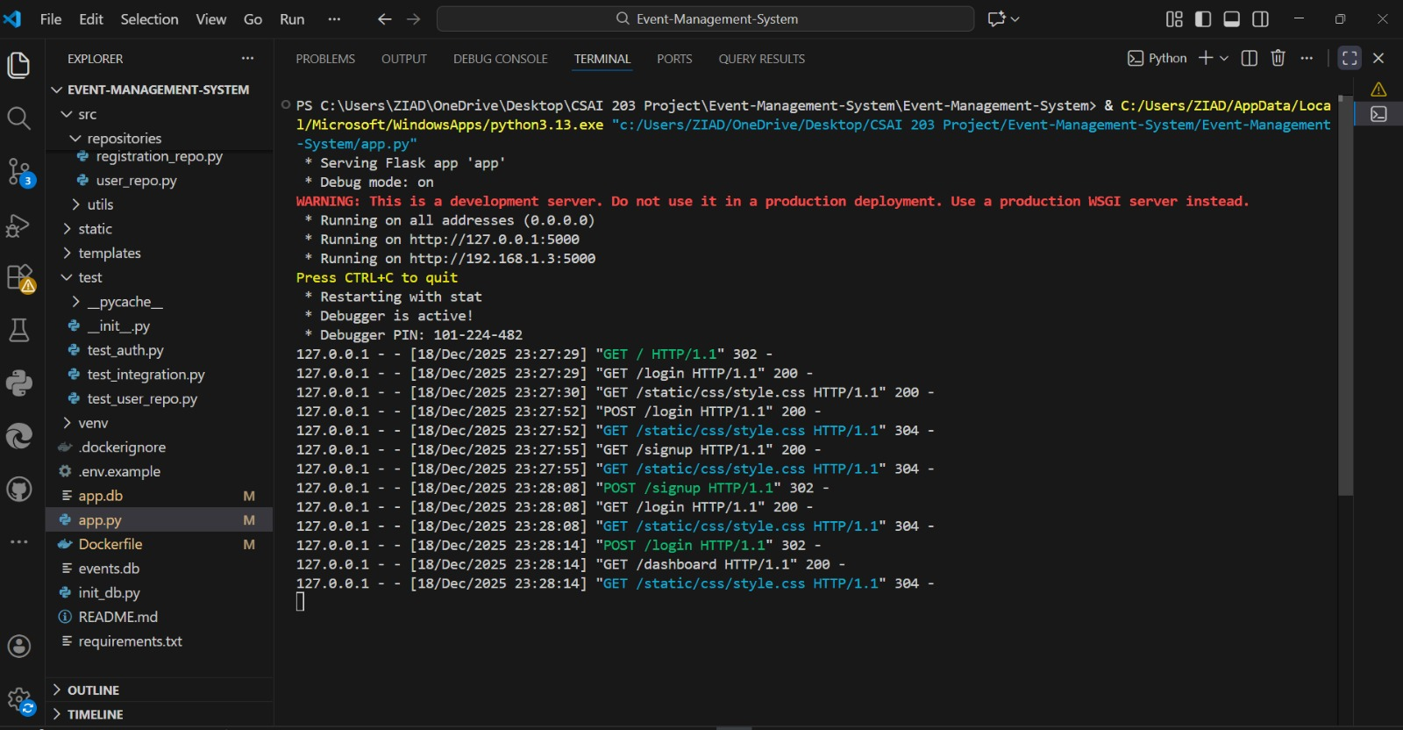
Docker Integration
Application containerized using Docker
Consistent runtime environment
Simplified deployment

Slide 12
Demo Flow
Application runs using Docker
User signs up
01
User logs in
02
Dashboard is displayed
03
User registers for an event
04
User submits feedback
05

Slide 13
Challenges & Solutions
Database handling in Docker
Testing with Flask application context
Git merge conflicts

Slide 14
Conclusion
All Phase 5 requirements were completed
MVC architecture improved system structure
The project meets course objectives

Slide 15

Thank you

